Slide 1
Workflows in Galaxy
Demo: Importing, creating and modifying workflows in Galaxy
Erik Hjerde

Slide 2
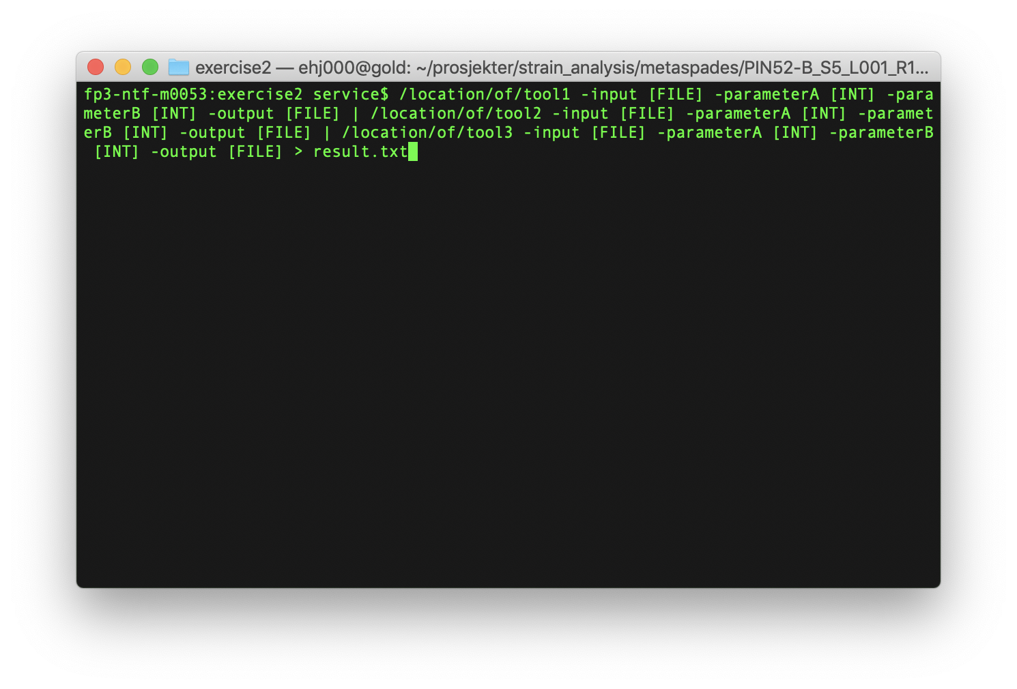
Workflows in Galaxy
Galaxy is a workflow manager with a graphical user interface
Workflows in Galaxy are strings of tools connected in the correct order so that the output from one tool becomes the input for the next tool
Tool 1
Tool 2
Tool 3
Output
Output
Output

Slide 3

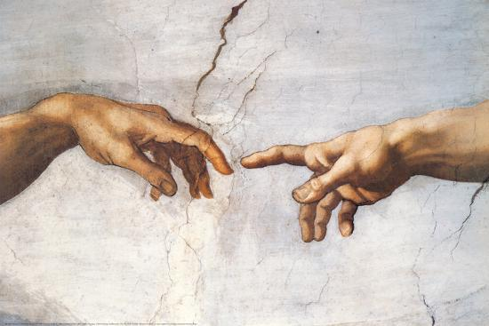




Workflows in Galaxy
Modify workflow
Create workflow
Share workflow
Documenting workflow
Run workflow
Notes:
This is the real beauty and strength of Galaxy
All through a user-friendly graphical interface in the web browser

Slide 4
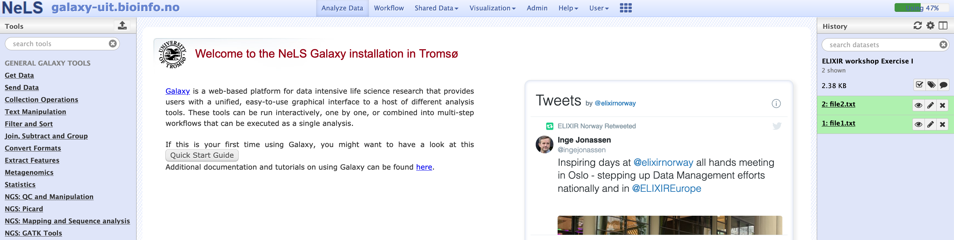
Live demo – feel free to join
Finding existing workflows in Galaxy
Modifying workflows in Galaxy
Sharing workflows in Galaxy
Constructing new workflows in Galaxy
Running workflows in Galaxy

Slide 5

The remaining slides are repetition of the most important things from the demo for later use when you go home and have forgotten everything you learned☺

Slide 6
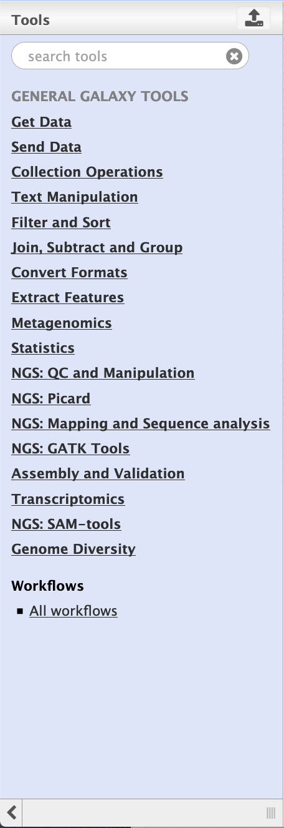
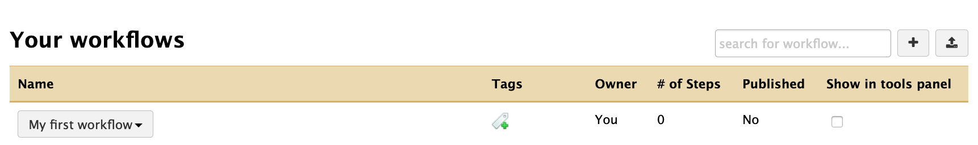
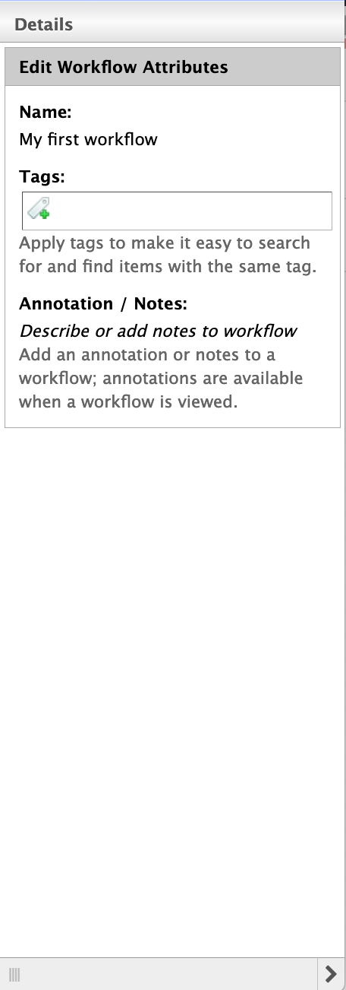
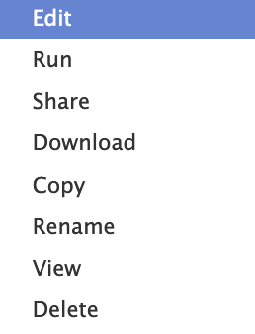
Workflows in Galaxy
Create, import or upload a workflow
Workflow page
Details panel
Context menu
Notes:
To create a new workflow, under the “Workflow” tab -> select ”+” (Create new workflow)
In the new window, give the workflow a name and a short description -> Press “Create”

Slide 7
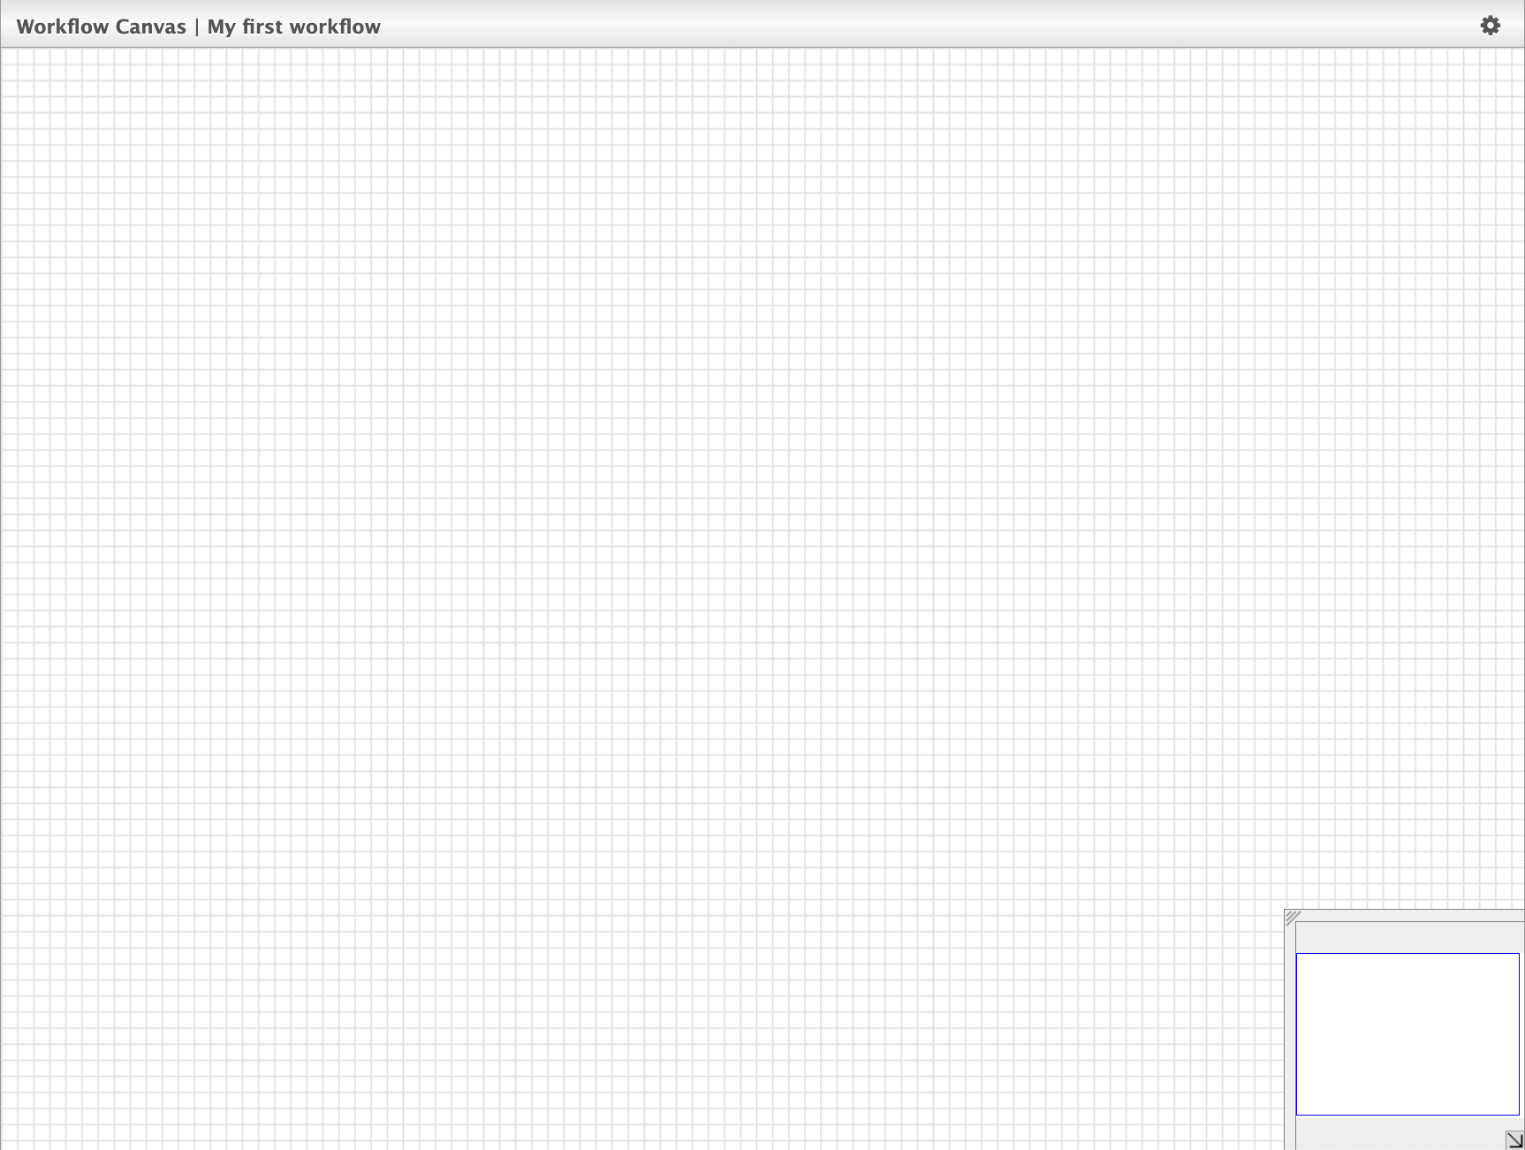
Workflows in Galaxy
Tools
Canvas navigation
Notes:
The Workflow Canvas will appear where you build the workflow

Slide 8
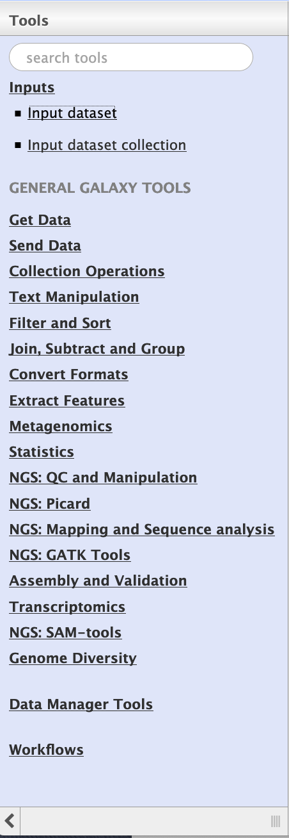
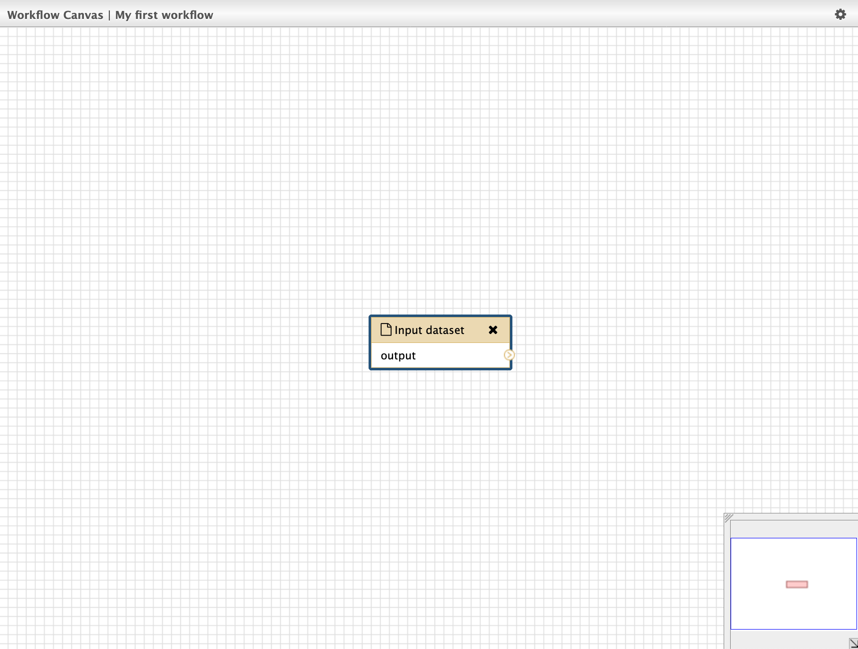
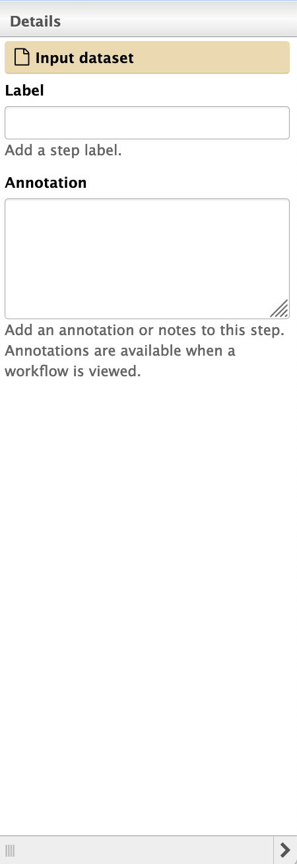
Workflows in Galaxy
Select tool
Tool attributes
Selected tool
Notes:
Selected tools to include from the tools menu will appear in the workflow canvas and can be labelled individually

Slide 9
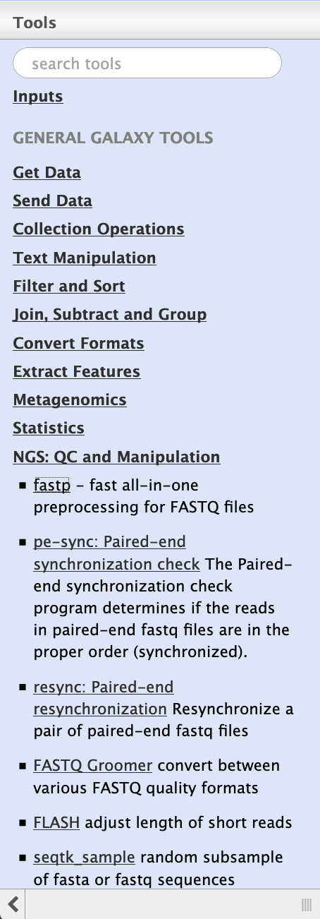
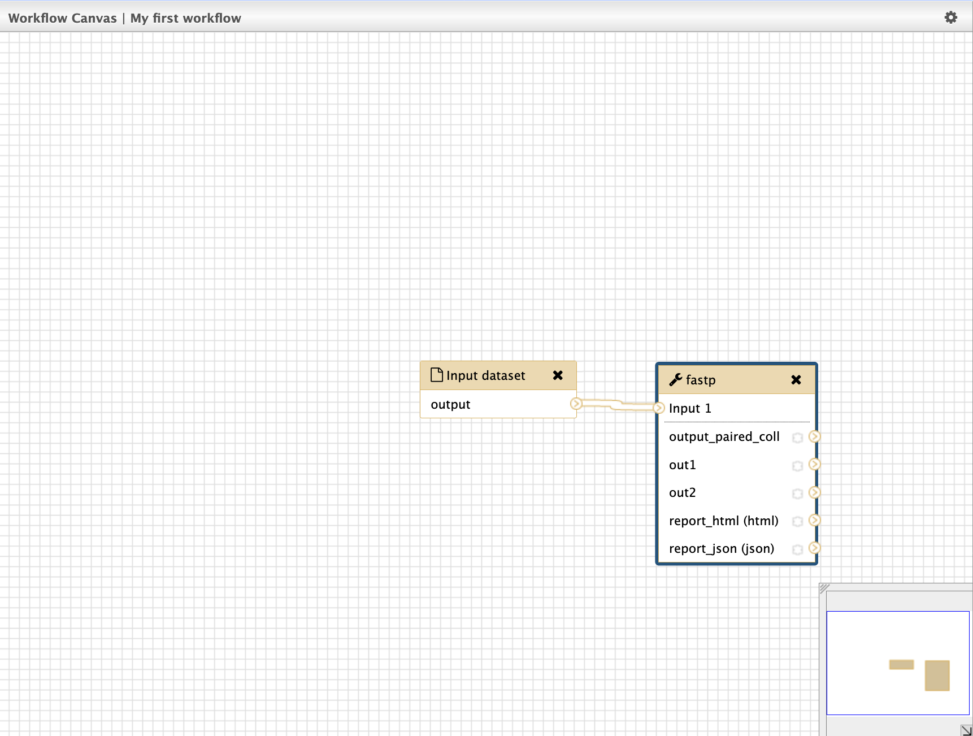
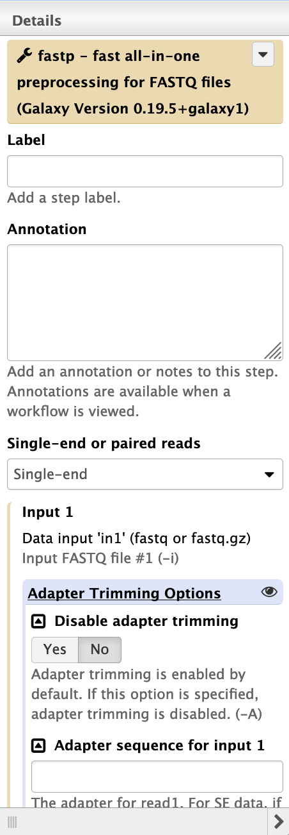
Workflows in Galaxy
New tool attributes Possible to pre-set parameter settings
Connect tools
Select new tool
Notes:
Connecting tools into a workflow
For each tools it is possible to set or even fix the parameter settings in advance, or it can be set at run time

Slide 10
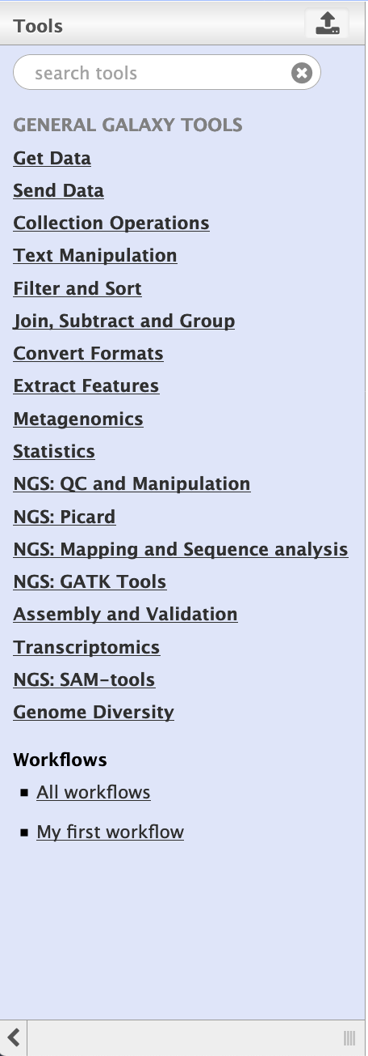
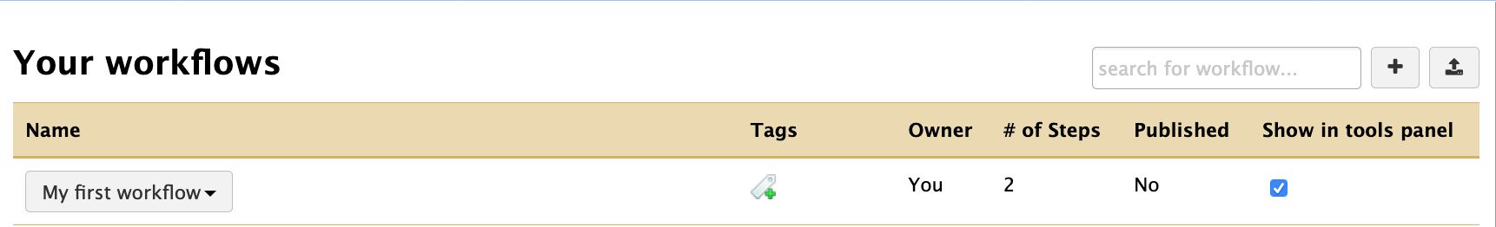
Workflows in Galaxy
New tool attributes Possible to pre-set parameter settings
Notes:
Workflow will be visible under the Workflows section in the Tools menu when activating “Show in tools panel”

Slide 11
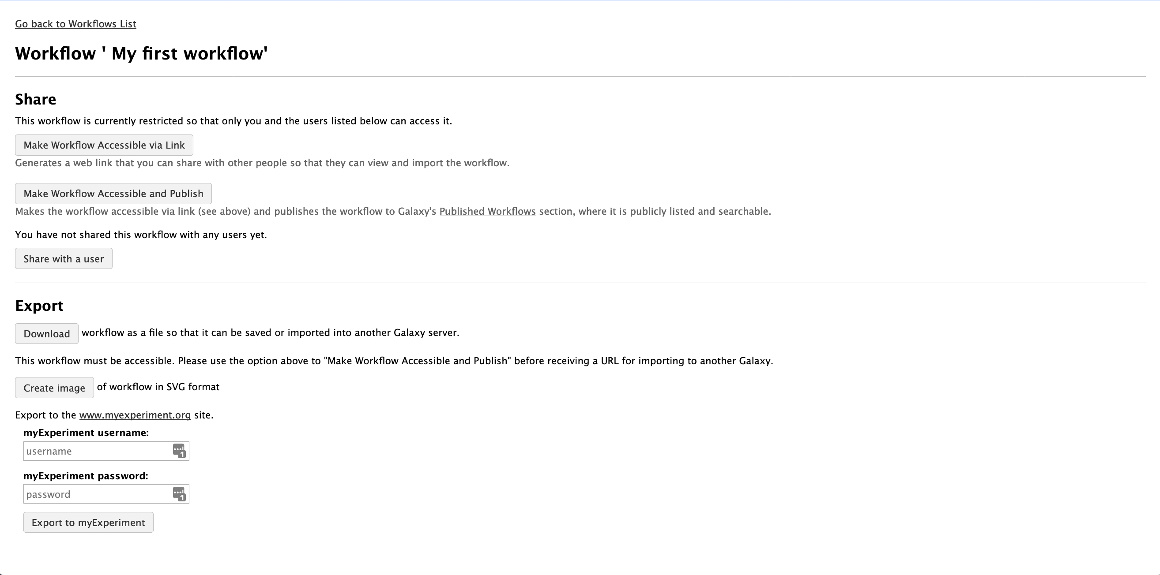
Sharing a workflow in Galaxy
Notes:
Options for sharing and exporting workflows

Slide 12
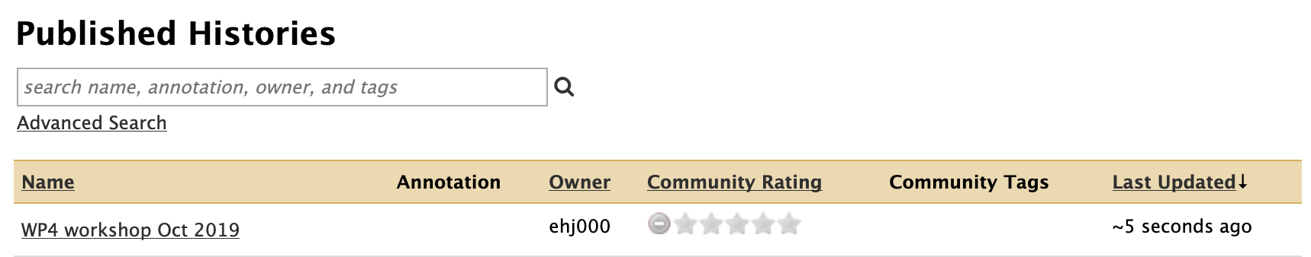
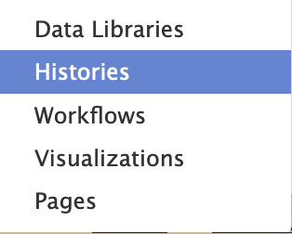
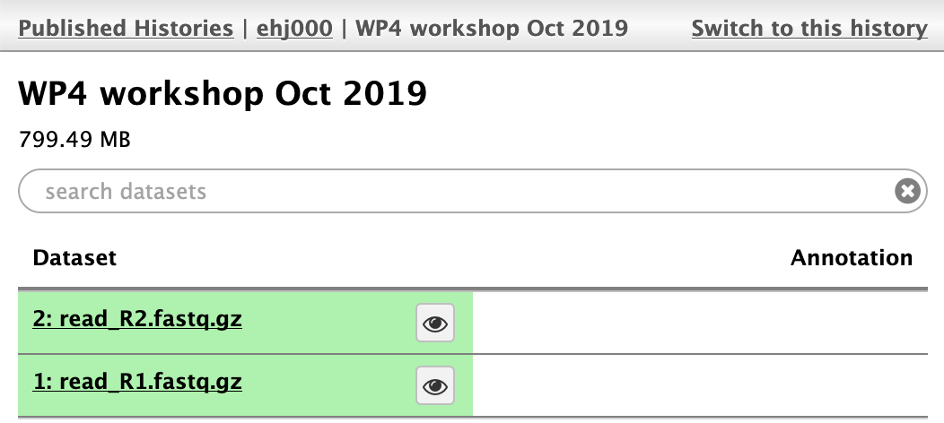

Import shared history
Histories shared by other users can be copied into your history

Slide 13
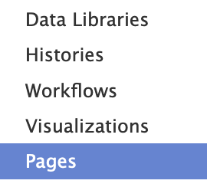
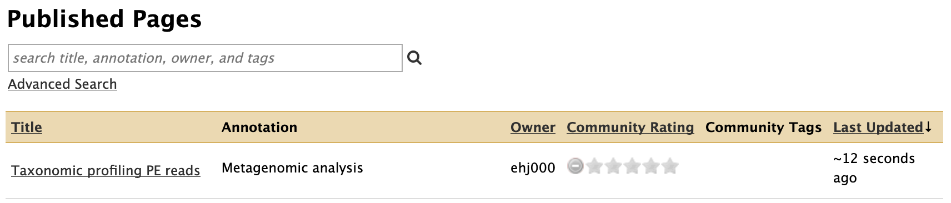
Accessing the documentation
The documentation in Pages can accessed by users under the “Pages” tab

Slide 14
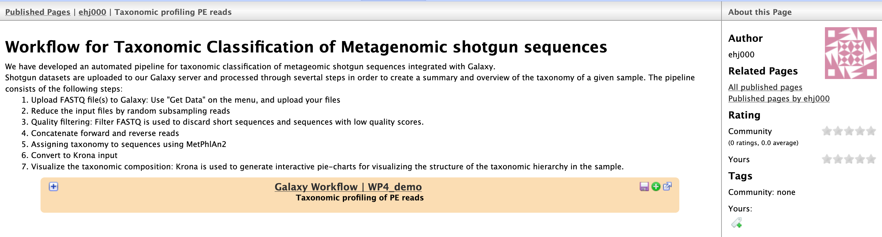
Accessing the documentation
The description of the workflow including an embedded overview is available

